Slide 1
NOTES AND PASSWORD MANAGER
su
Under the supervision of
B.NARASIMHA SIR
Associate Professor School of
Computer Science & Artificial Intelligence
Presented for
Milestone 3-Final Minor Project Review
Date:26-04-2024
Candidate No. & Name
HTNO. | Name
2103A51091 2103A51304 2103A51328 2103A51494 2103A51408 | J.TEJA B.SAHITH M.DEEKSHITH REDDY S.TEJASWI K.SAMPRADHA

Slide 2
Outline of the Presentation
S. No | Topic
1 | Abstract
2 | Motivation and Background
3 | objectives
4 | Introduction
5 | Literature review
6 | Existing system,disadvantages,Existing methodology
7 | Elements used in project,Result screens
8 | Conclusion

Slide 3
Abstract
Note taking is a very good habit to organize our daily life. This is an online android application which helps to take notes at anytime and helps to generate a very strong password for your account security and makes the same available whenever you need. Basically it's a two-in-one web application. It is a software application designed to provide a secure and efficient solution for managing and safeguarding sensitive information such as passwords and notes.

Slide 4
Motivation and Background
Strong passwords that are different for every platform are essential due to the increasing number of online accounts. Nonetheless, it was challenging to remember complicated passwords, and using weak or common passwords poses serious security hazards. It can be difficult to locate crucial information while using traditional note-taking techniques like ink and paper or dispersed digital files because they are frequently tangled and unsafe.
It is for this reason that a safe and intuitive Java web application for managing notes and passwords is being developed. Because Java is platform independent, it can be used on various operating systems. Furthermore, secure password storage is made possible by cryptographic libraries like JCA and built-in security mechanisms. Lastly, Java offers a solid basis for development thanks to its large developer community and resources. The goal of this project is to develop a single, comprehensive solution for internet security and information organization.

Slide 5
OBJECTIVES
It’s a GUI-based project using the swing library to organize all the elements that work under the Notes and password Manager. It's going to have two major functionalities at the same time.
Note taking & password managing are one of the most overlooked virtual activities in today's digital age.
Various companies are constantly adding new features to note taking and password management.
So, instead of having and maintaining two different apps in your system, we'll be developing a single web application which can perform both of these activities.

Slide 6
Introduction
Welcome to our Notes and Password Manager web application! Designed to streamline your digital life, our platform offers a secure and convenient way to manage both your notes and passwords. With just a few clicks, you can store, retrieve, and update your notes, ensuring that important information is always at your fingertips. Additionally, our password management feature provides a safe haven for your sensitive login credentials, allowing you to effortlessly organize and access them as needed. Whether you're jotting down meeting minutes or safeguarding your online accounts, our application prioritizes efficiency and security, empowering you to take control of your digital world with ease.

Slide 7
Literature Review
Analysis on the Security and Use of Password Managers*Carlos Luevanos1, John Elizarraras2, Khai Hirschi3, and Jyh-haw Yeh41Dept. of Computer Science, Willamette University, CA2North Star Charter High School, Eagle, ID;3Capital High School, Boise, ID4Dept. of Computer Science, Boise State University.
A Study for an Ideal Password Management SystemA paper published in the International Journal for Research in Applied Science & Engineering Technology (IJRASET) in 2022Analysis on the Security and Use of Password ManagersA paper that discusses the use of password managers, including periodic renewal, user authentication systems, and instant availability.

Slide 8
EXISTING SYSTEM
Different tools and techniques are widely used in today's encryption and password management environment. Without integration and security, most users use notebooks, writing apps, and actual books to write. Password management also comes with the risk of security breaches and is not easy as it relies on memory, typing passwords or using simple browser functions. This inconsistency leads to security breaches, potential for data loss, and poor performance.
There is an urgent need for an integrated system that combines password management and writing functionality. Such a platform will provide fast access, strong security features (such as encryption and password generation), and seamless organization. By integrating these important functions into a single system, users can increase efficiency, reduce security threats and ensure the protection of confidential information.

Slide 9
Disadvantage of Exsisting system
There are some flaws in the current script and password management. First, inconsistentnature, relying on a variety of tools and methods, leads to ineffectiveness and conflict. Users often find it difficult to find information quickly, resulting in decreased productivitySecond, the lack of security protection poses a serious risk to sensitive information. Storing password in plain text or using easily forgotten passwords increases vulnerability to unauthorized access and possible breaches.
Additionally, the lack of features such as encryption and shared security further hinders security. Additionally, relying on manual processes such as writing passwords on paper limits functionality and poses the risk of physical loss or theft. Overall, the shortcomings of the current system include inefficiencies, inconsistencies, and distrust. These show the urgent need for greater integration and security for managing accounts and passwords.

Slide 10
Existing methodology
Current methods for managing passwords and accounts often involve the use of a variety of tools and methods. Writing is often done using applications like Microsoft Word, Evernote, or notebooks that lack integration and make organization cumbersome, especially across multiple platforms. Similarly, password management often relies on memorizing, writing down passwords, or using simple browser functions. This may compromise security and ease of access. These separations are ineffective and could potentially hinder security.
Users face challenges in keeping their digital activities consistent and secure. Additionally, there are no advanced features such as encryption, password creation, and shared security, which will further affect efficiency and security. In general, the current system is characterized by fragmentation, inefficiency, and security risks, requiring the development of a more integrated and sustainable security solution to manage text and passwords correctly.

Slide 11
Gaps identified
There are some flaws in the current text and password:Fragmented approach: Relying on different tools and methods for reminders and password management is causing an explosion. Users need to switch between different applications; This creates inefficiencies and compliance management issues. Storing passwords in plain text or using weak authentication methods increases the risk of a breach.
Most users need to manually transfer messages between different platforms; This is a time-consuming and error-prone process. Users may have difficulty finding information quickly, which may result in decreased performance. This limits the functionality and security of existing systems. Good security measures and efficient organization.

Slide 12
Problem Identification ````````````````````````````````````````````````````
There are some flaws in the current text and password: Fragmented approach: Relying on different tools and methods for reminders and password management is causing an explosion. Users need to switch between different applications. This creates inefficiencies and compliance management issues. Storing passwords in plain text or using weak authentication methods increases the risk of a breach.
Most users need to manually transfer messages between different platforms. This is a time-consuming and error-prone process. Users may have difficulty finding information quickly, which may result in decreased performance. This limits the functionality and security of existing systems. Good security measures and efficient organization.

Slide 13
Elements used in the Project ````````````````````````````````````````````````````
User Interface (UI):
The project features a user-friendly graphical user interface (GUI) designed for ease of use and navigation.
UI elements include buttons, text fields, text areas, labels, and themes to enhance the visual appeal and customization options.
Password Management:
Password generation: A password generator is included to create strong and random passwords.
Password storage: The application allows users to store and manage login credentials for online accounts.
Password search: Users can search for and retrieve stored passwords as needed.

Slide 14
Elements used in the Project ````````````````````````````````````````````````````
Notes Management:
Adding Notes: We can add note which we need to remember at a particular time.
Getting Notes: We can get the note which we have added.
Cross-Platform Compatibility:
The project is designed to be cross-platform, enabling it to run on various operating systems, making it accessible to a broad user base.
The project is designed to be cross-platform, enabling it to run on various operating systems, making it accessible to a broad user base
Java Swing Library:
The project utilizes Java's Swing library to create the graphical user interface and interactive elements.
Data Structures:
The project employs data structures like arrays, lists (Array List), and hash tables (Hash table Password) to store and manage passwords, notes, and other information efficiently.

Slide 15
Important points derived through Literature reivew
I have learned what is sentiment analysis.Granularity,major trends in sentiment Analysis and future directions in sentiment analasys.
context sensitive analysis,sarcasam,multiple domain adaptions are useful for my research
context sensitive analysis helps me to reduce error in data
sarcasam detenction to help in better analysis
multiple domain adaptions helps to under stand domain characterstics and to get large amount of data.

Slide 16
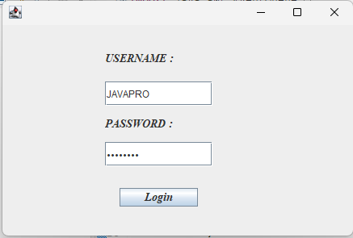
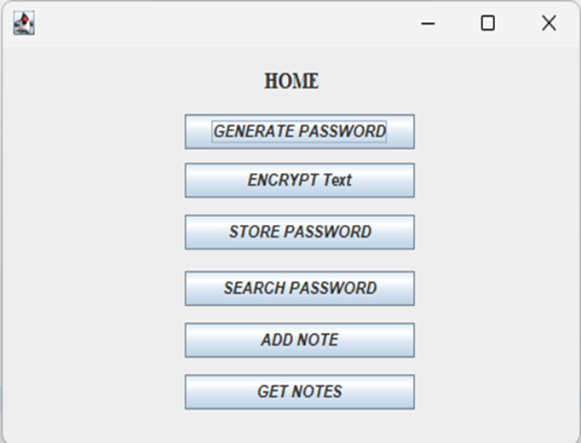
RESULT SCREENS:
LOGIN PAGE
HOME PAGE

Slide 17
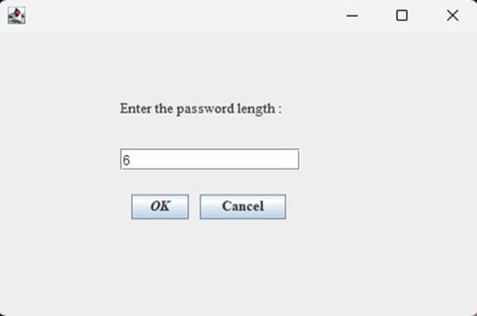
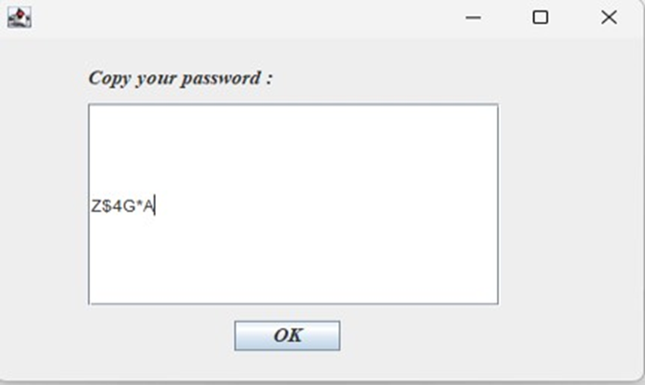
RESULT SCREENS:
GENERATE PASSWORD

Slide 18
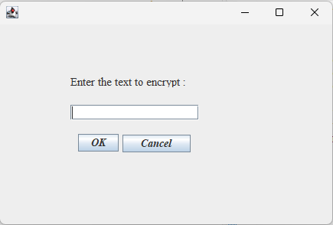
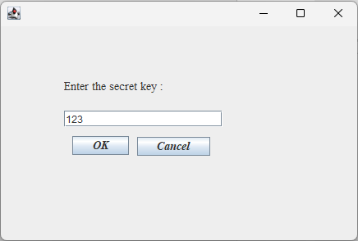
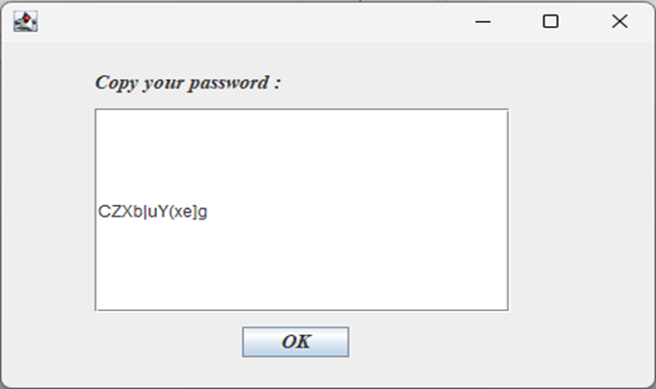
RESULT SCREENS:
ENCRYPT TEXT

Slide 19
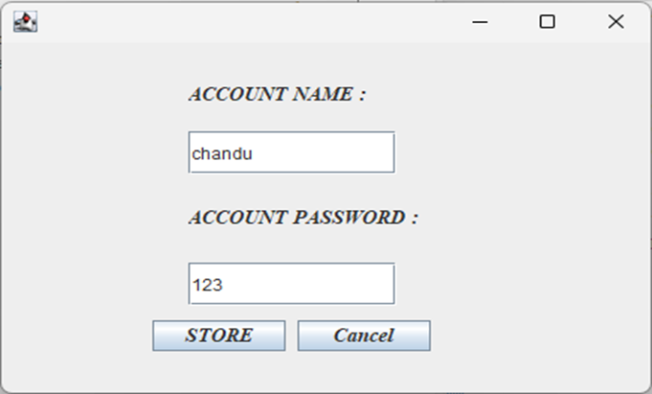
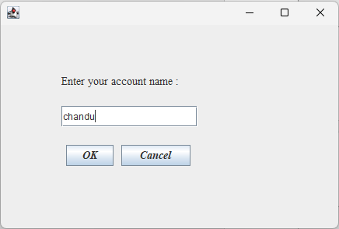
RESULT SCREENS:
STORE PASSWORD
SEARCH PASSWORD

Slide 20
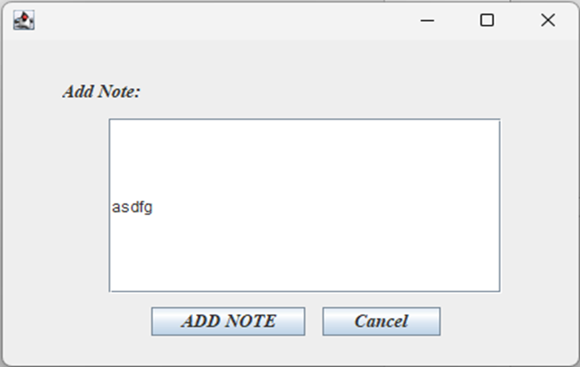
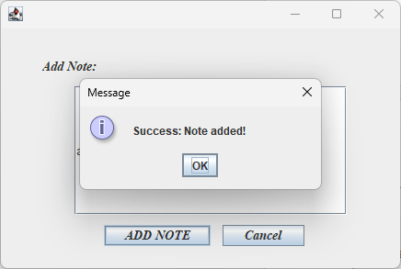
RESULT SCREENS:
ADD NOTE

Slide 21
Comparative study of proposed and existing systems
Integration and Centralization:
Existing systems: without integration and in the middle, rely on different tools and processes for notifications and password management. Feature that provides central access to all user information. , there are security risks
Recommendations: Create a secure encryption algorithm to store passwords, ensure confidential information through a secure authentication protocol, and provide better security to protect user data.
User Experience:
Key Features: User experience may vary depending on device and application and can often lead to inefficiency and frustration. The user-friendly interface, seamless navigation, and convenient organization increase productivity and usability before users even know how to type and use passwords.

Slide 22
Comparative study of proposed and existing systems
System:
Limited functionality with basic features for typing and password management, but without advanced features such as password generation and security sharing. It provides users with various features and useful platforms. For users with varying needs or managing large files.
Security and Privacy:
Key Features: Most vulnerable to security breaches and data breaches Leaks due to weak security and data fragmentation. System: Prioritize security and privacy through strong encryption, secure authentication, and data protection measures to ensure the confidentiality and integrity of user information.

Slide 23
Conclusion:
The Notes and Password Manager project is a versatile and essential web application that addresses the critical need for managing and safeguarding sensitive information in today's digital age. This project's core objective was to create a user-friendly, secure, and feature-rich solution for effectively managing passwords and notes while prioritizing data security and user convenience.

